Slide 1
Lit Bell Ringers
Oct. 6-10

Slide 2
Monday, October 6th- Vocabulary
Create a Frayer model for onomatopoeia. Use your textbook if needed.

Slide 3
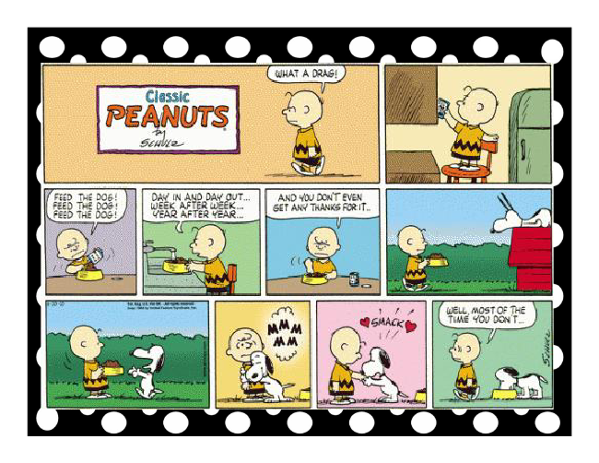
Tues. Oct. 7th- Figurative Language
Directions: Read
the comic and
list the
examples of
onomatopoeias.

Slide 4
Wed. October 8th- Root Words
Directions: Write the root words, definitions, and then come up with at least 1 word that includes the root word.
Rupt-break
Brev- short
Cap-head

Slide 5
Thurs. Oct. 9th-Aspire Test Prep
Directions: Write the analogies below. Choose the best answer.
1. bird: wing:: person:_______
Beak
Arm
Neck
Kite
2. herd: cattle:: flock: ________
Sheep
Bread
Lions
Students
3. ocean: waves:: atmosphere: ________
Fire
Heaven
Birds
winds

