Slide 1
Language Bell Ringers
Nov. 3-7

Slide 2
Monday, Nov. 3rd- Grammar
Directions-Identify the following sentence patterns.
1. “Negotiations are my thing,” said Si.
2. If you’ll stop right now, I’ll replace your bumper.
3. Susie and Jake watched a movie, and they ate in the food court.
4. When we finish our novel, we will read a play, and we will watch the TV show.
5. What did you do last night?

Slide 3
Tues. Nov. 4th-Frayer models
1. Foresight(noun)-the ability to anticipate what might happen in the future
2. Fragrance(noun)-a sweet or fragrant smell
3.Furtive, (adj)-done or acting in a way that is intended to not be noticed

Slide 4
Examples
Vision, hindsight
Perfume, stench
Secretive, open

Slide 5
Wed. Nov. 5th-quote
Directions: Write the quote of the week. Then respond to it/ explain the meaning/ make a connection in 3-4 sentences.

Slide 6
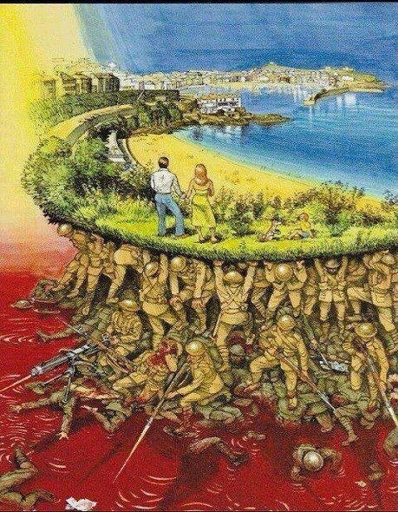
Thurs. Nov. 6th-journal
Directions: Evaluate the
picture to the right. Explain its
meaning in a 6-7 sentence
journal entry.

