Slide 1
Language Bell Ringers
Sept. 22-26

Slide 2
Mon. Sept. 22nd- grammar
Directions: Write the sentences below and add punctuation marks and capitalization where needed.
after the long drive we finally made it to disney world but it was closed because of a Hurricane warning
we were so excited about riding Roller coasters seeing mickey and touring the Castle

Slide 3
Tues. Sept. 23rd- vocabulary
Directions: Create Frayer models for the following words.
1. Defiant-(adjective) bold opposition to authority
2. Deft-(adjective) quick, skillful
3. Destination (noun)-predetermined place

Slide 4
Wed. Sept. 24th- Quote
Directions: Write the quote of the week and explain what you think it means. Can you make a connection to the quote? If so, explain.

Slide 5
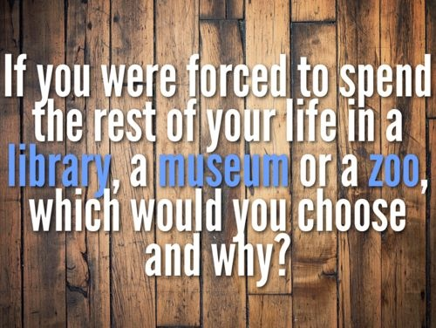
Thurs. Sept. 25th- Journal
Directions: Respond to the journal prompt in 5-6 sentences.

